Slide 1
Server side and client side scripting

Slide 2
What Is Server-side Scripting?
The execution of several programs on the back-end or specifically the servers, is said to be Server-side programming or Server-side scripting.
Many functionalities are added in the web application for better user experience with the help of the programs that run on the backend.
Hence, this is also called Back-end Programming.
The main question is why do we need server-side or backend programming?
Because when we deal with huge collections of data, we need servers that have databases to store such a huge amount of data. Then server-side programs are used to perform various operations on that data.
In simple words, All the backend-code is maintained on the servers.

Slide 3
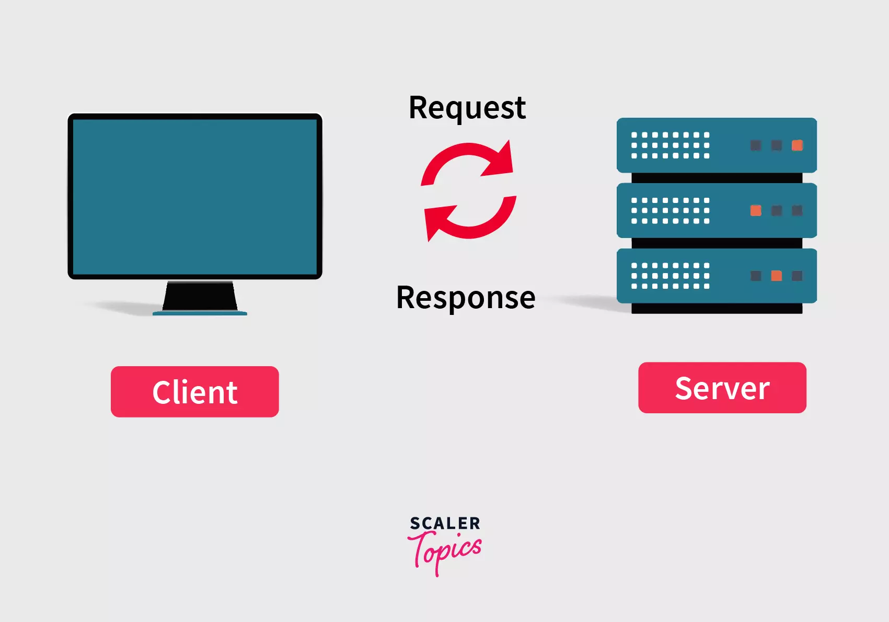

Slide 4
APPLICATIONS OF SSS:
1. Server side scripting is used to protect the credential (username and password). When the user signs up any login web page first time, username and password are saved in the server.
Whenever a user wishes to log in, the web server verifies the credential (username and password) of the user with the username and password stored in the server. If they are matched, the user will be allowed to access the server side resources.
2. Whenever we submit an online application, the data or information entered in the form is stored in the database of the server.
Once the information is successfully submitted to the server via online forms, the information from the server can be accessed and represented in the form of report, forms, etc.

Slide 5
3. It is used at backend, where the source code is not visible to the client.
4. Server side script can be used for creating and applying complex business logics.
5. It can be used to customize a web page to make it more useful for individual clients.

Slide 6
Programming Languages for Server-side Programming
There are so many languages that we can use for server-side programming but some popular ones are -
PHP
Node.js
C# (read as 'C sharp')
Ruby
Python

Slide 7
Examples of Server-side Programming
Here we have the example of google, like as we search for something on google, we are just requesting for some specific data, now google performs some programming on the server-side and gives back the related found results.
or
Like flipkart use server-side programming to deliver the appropriate search results, product suggestions, special offers, etc. to the users based on their previous searches, etc.

Slide 8
What is Client-side Scripting?
The execution of several programs on the front-end or specifically the Client, is said to be Client-side programming.
Hence, this is also called Front-end Programming.
But What is the motive of Client-side programming?
The main motive of client-side programming is to create interactive and appealing web pages, utilizing the power of temporary storages such as local storage and session storage and reducing the server load.

Slide 9
Application of Client side Scripting
Some important applications of client side scripting are listed, as below:
To retrieve data from web browser or user’s screen.
Client side scripting is used for validation purpose. If the user enters incorrect credentials on the login page, the web page displays an error message on the client machine without submitting it to the web server.
To create ad banners that interact with the user, rather than simply displaying graphics.
To create animated images that change when we move the mouse over them.

Slide 10
Programming Languages for Client-side Programming
There are so many languages that we can use for client-side programming but some popular ones are -
HTML
CSS(cascading style sheets)
JavaScript

Slide 11
Examples of Client-side Programming
Form validation is one of the best examples of client-side programming. The data input by the user is verified before it is sent to the server.
Once the data is validated on the client side, it is sent to the server for further process.
Let's take the example of user sign in, when the user enters the email address, it is first checked on the client-side itself if it is having a proper structure like "@" symbol, "." extension like .com, .org, etc.
Once it is verified, then it is passed on to the server to check if the entered email actually exists or not. This helps in reducing the load on servers.

Slide 12
Client-Side Scripting | Server-side Scripting
It is executed on the client side i.e. Front-end. | It is executed on the server side i.e. Back-end
It is visible to the user | It is not visible to the user
Useful in various frontend Operations | Useful in various backend operations
It can be used to collect the input given by the user | It can be used to process the input given by the user
It is not preferred for performing complex computations and transactions | It is preferred for performing complex computations and transactions
It is generally less secure | It is generally more secure
HTML, CSS and JavaScript are used for Client-side programming | Node.js, PHP, Python and Java are used for Server-side programming

